Slide 1
PCA based Face Recognition

Slide 2
Eigenfaces
PCA reduces the dimension of the data
Speeds up the computational time

Slide 3
Eigenfaces, the algorithm
Assumptions
  Square images with Width = Height = N
  M is the number of images in the database
  P is the number of persons in the database

Slide 4
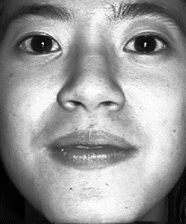
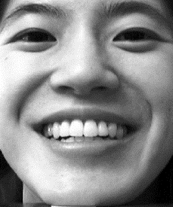
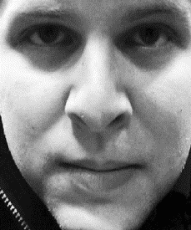
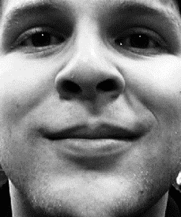
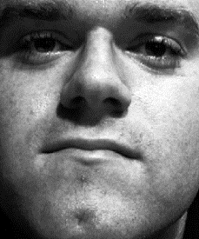
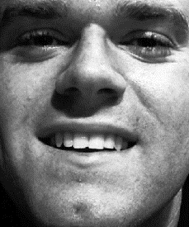
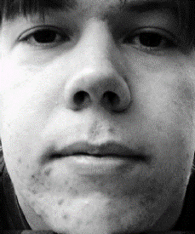
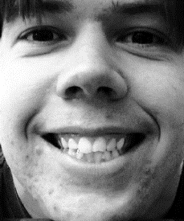
Eigenfaces, the algorithm
The database

Slide 5
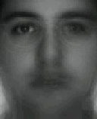
Eigenfaces, the algorithm
We compute the average face

Slide 6
Eigenfaces, the algorithm
Then subtract it from the training faces

Slide 7
Eigenfaces, the algorithm
Now we build the matrix which is N² by M
The covariance matrix which is N² by N²

Slide 8
Eigenfaces, the algorithm
Find eigenvalues of the covariance matrix
  The matrix is very large
  The computational effort is very big
We are interested in at most M eigenvalues
  We can reduce the dimension of the matrix

Slide 9
Eigenfaces, the algorithm
Compute another matrix which is M by M
Find the M eigenvalues and eigenvectors
  Eigenvectors of Cov and L are equivalent
Build matrix V from the eigenvectors of L

Slide 10
Eigenfaces, the algorithm
Eigenvectors of Cov are linear combination of image space with the eigenvectors of L
Eigenvectors represent the variation in the faces
V is Matrix of eigenvectors

Slide 11
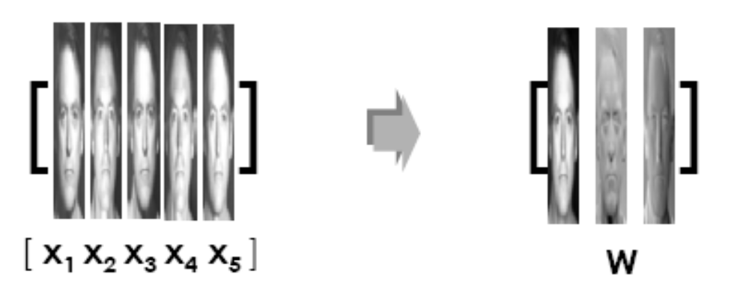
Eigenfaces, the algorithm
A: collection of the training faces
U: Face Space / Eigen Space

Slide 12
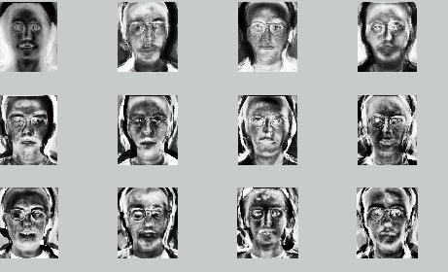
Eigenfaces
Eigenface of original faces

Slide 13
Eigenfaces, the algorithm
Compute for each face its projection onto the face space
Compute the threshold

Slide 14
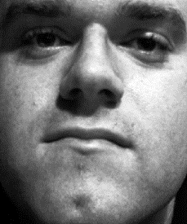
Eigenfaces: Recognition Procedure
To recognize a face
Subtract the average face from it

Slide 15
Eigenfaces, the algorithm
Compute its projection onto the face space U
Compute the distance in the face space between the face and all known faces

Slide 16
Eigenfaces, the algorithm
Reconstruct the face from eigenfaces
Compute the distance between the face and its reconstruction

Slide 17
Eigenfaces, the algorithm
Distinguish between
  If then it’s not a face; the distance between the face and its reconstruction is larger than threshold
  If then it’s a new face
  If then it’s a known face because the distance in the face space between the face and all known faces is larger than threshold

Slide 18
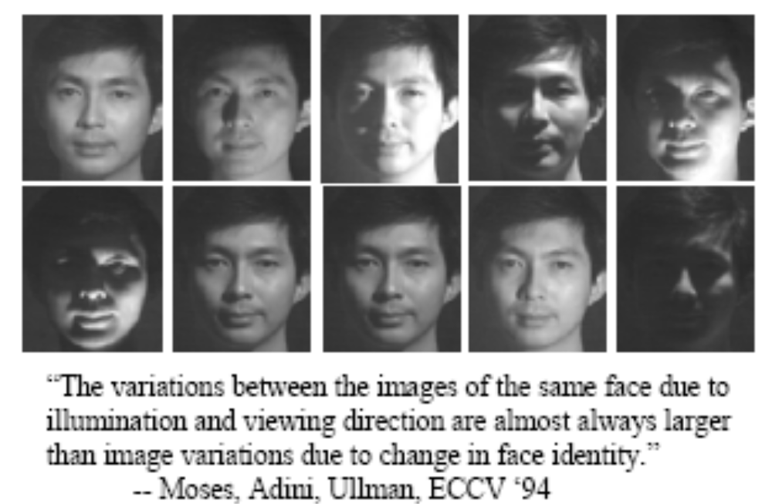
Eigenfaces, the algorithm
Problems with eigenfaces
  Different illumination

Slide 19
Eigenfaces, the algorithm
Problems with eigenfaces
  Different head pose
  Different alignment
  Different facial expression

Slide 20
References
[1] M. Turk, A. Pentland, “Face Recognition Using Eigenfaces”
[2] J. Ashbourn, Avanti, V. Bruce, A. Young, ”Face Recognition Based on Symmetrization and Eigenfaces”
[3] http://www.markus-hofmann.de/eigen.html
[4] P. Belhumeur, J. Hespanha, D. Kriegman, “Eigenfaces vs Fisherfaces: Recognition using Class Specific Linear Projection”
[5] R. Duda, P. Hart, D. Stork, “Pattern Classification”, ISBN 0-471-05669-3, pp. 121-124
[6] F. Perronin, J.-L. Dugelay, “Deformable Face Mapping For Person Identification”, ICIP 2003, Barcelona
[7] B. Moghaddam, C. Nastar, and A. Pentland. A bayesian similarity measure for direct image matching. ICPR, B:350–358, 1996.
http://www.face-rec.org/interesting-papers/

